Slide 1
Department of CSE, CSIT
COURSE NAME: Data science
COURSE CODE: 24AD3107
Topic:
Introduction to Data Science
Session - 1

Slide 2
AIM OF THE SESSION
To familiarize students with the basic concept of Data science
INSTRUCTIONAL OBJECTIVES
This Session is designed to: Introduction to Data science and Evolution of Data Science
LEARNING OUTCOMES
At the end of this session, you should be able to: basic knowledge of Data Science

Slide 3
Key Concepts
SESSION INTRODUCTION
Introduction of Data Science
Scope of Data Science
Need and Career Opportunities
Applications of Data Science in Real-world

Slide 4
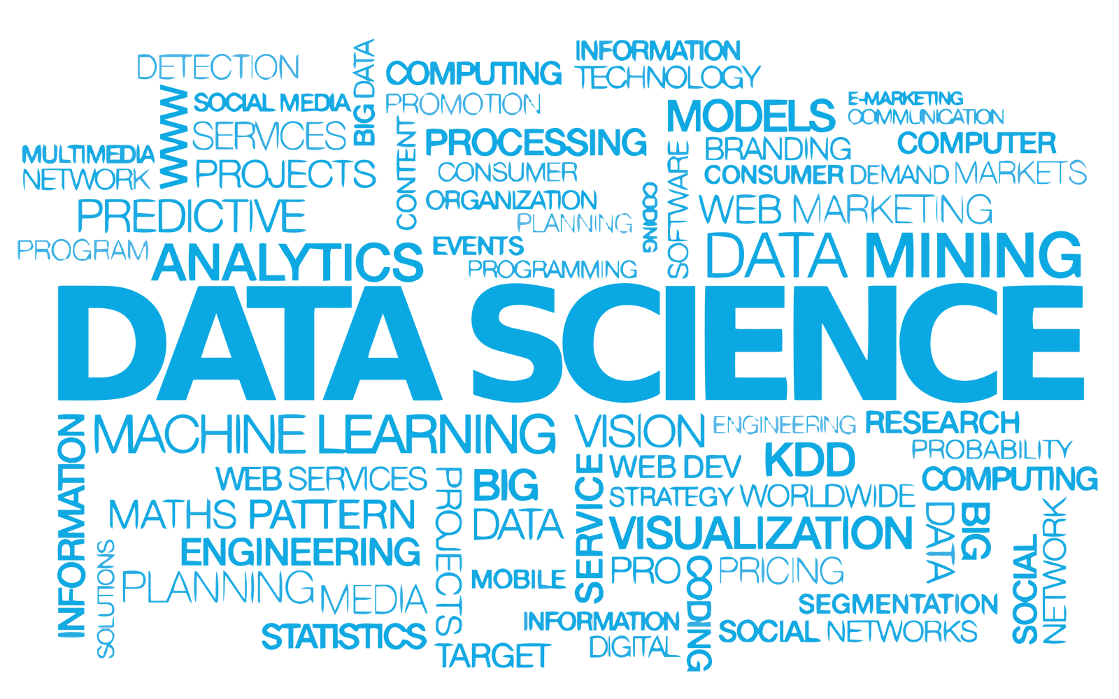
DATA SCIENCE VOCABULARY
4

Slide 5
Introduction to
Data Science
Data Types
Python
NumPy
Pandas
Pipelines
B.Tech · Academic Year 2025–26

Slide 6
WHAT IS DATA SCIENCE?
Data science is the study of data to extract meaningful insights for business and decision making. It is a multidisciplinary approach that combines principles and practices from the fields of mathematics, statistics, artificial intelligence, machine learning, visualization and computer engineering to analyze large amounts of data.
It combines:
Statistics
Mathematics
Computer Science
Artificial Intelligence
Machine Learning
Domain Knowledge
The primary objective of Data Science is to analyze data and transform it into meaningful information for decision-making.
5

Slide 7
WHAT IS DATA SCIENCE?
Data science starts with data, which can range from a simple array of a few numeric observations to a complex matrix of millions of observations with thousands of variables.
Data science utilizes certain specialized computational methods in order to discover meaningful and useful structures within a dataset.
The discipline of data science coexists and is closely associated with a number of related areas such as database systems, data engineering, visualization, data analysis, experimentation, and business intelligence (BI).
5

Slide 8
Evolution of Data Science
The evolution of Data Science occurred due to the rapid growth of digital data generated from:
Social media
IoT devices
Banking systems
Healthcare systems
E-commerce platforms
Cloud computing
Traditional data processing methods became insufficient to handle large volumes of data, leading to the development of Data Science techniques.

Slide 9
NEED FOR DATA SCIENCE
In the modern digital world, enormous amounts of data are generated every second from:
Social media platforms
Banking systems
Healthcare systems
Online shopping websites
Mobile applications
IoT devices
This data is called Big Data. Traditional data processing methods cannot efficiently handle such huge volumes of data. Therefore, Data Science has become essential for extracting meaningful insights and making intelligent decisions.

Slide 10
The organizations generate huge amounts of data daily and Data Science helps to :
Analyze data
Predict future outcomes
Improve business performance
Automate processes
Solve real-world problems
Managing large datasets
Discovering hidden patterns
Automating intelligent systems
Example
Netflix uses Data Science to recommend movies based on user preferences.
Amazon uses Data Science for product recommendations and demand forecasting.

Slide 11
MAJOR COMPONENTS OF DATA SCIENCE
1. Statistics: Used for:
Data analysis
Probability calculations
Hypothesis testing
Prediction
2. Mathematics Includes:
Linear algebra
Calculus
Probability theory
3. Programming
Languages commonly used:
Python
R
SQL
Java
4. Machine Learning
Allows systems to learn from data automatically.
5. Data Visualization
Represents data using:
Charts
Graphs
Dashboards
6. Domain Expertise
Understanding the application area is essential

Slide 12
SCOPE FOR DATA SCIENCE
The scope of Data Science is continuously expanding across multiple industries. It helps organizations:
Improve decision-making
Automate processes
Predict future outcomes
Enhance efficiency
Deliver personalized services
Data Science will continue to play a critical role in solving real-world problems and driving innovation.

Slide 13
1. Healthcare : Hospitals and healthcare organizations use large amounts of patient data to make accurate decisions and improve patient care.
Applications:
Disease prediction - predict diseases before they become severe.
Medical image analysis - identify abnormalities quickly and accurately using medical images such as X-Rays, MRI scans, CT scans
Drug discovery - pharmaceutical companies analyze chemical compounds and biological data to develop new medicines faster.
Example: COVID-19 pandemic, Data Science techniques were used to identify vaccine candidates and predict drug effectiveness.

Slide 14
Electronic Health Records (EHR) – Maintaining digital records of patient such as medical history, prescriptions, test reports, diagnoses.
Example : Doctors can access patient history instantly and provide personalized treatment recommendations.
AI systems predict diseases like cancer using patient data.
2. Banking and Finance: improve security, customer service, and financial decision-making.
Applications:
Fraud detection - monitor financial transactions and identify suspicious activities.
Credit scoring - evaluates customer financial history to determine creditworthiness
Risk analysis - Financial institutions use predictive analytics to estimate investment risks and market fluctuations.
Stock market prediction - Historical stock market data is analyzed to forecast future price trends.
Example: Banks use machine learning to detect suspicious transactions.

Slide 15
3. E-Commerce: to understand customer behavior and improve sales
Applications:
Product recommendations - analyze customer browsing and purchase history such as Amazon recommends products based on previous purchases and customer interests.
Customer segmentation - Customers are grouped based on age, interest, buying behavior, location.
Example: Online stores target advertisements to specific customer groups for better sales
Demand forecasting - Predicts future product demand using historical sales data.
Example : Amazon/Flipkart recommends products based on purchase history.
4. Education: teaching methods and student performance
Applications:
Student performance analysis
Personalized learning
Attendance prediction

Slide 16
5. Cyber security: to protect systems and networks from cyber threats
Applications:
Intrusion detection - Detects unauthorized access to systems and networks like unusal login activities
Malware analysis - identifies malicious software behavior
Threat intelligence - Analyzes cyber threat data to predict future attacks.
6. Agriculture: for smart farming and increased crop productivity
Applications:
Crop prediction – based on weather conditions, soil quality, rainfall farmers decide which crop to grow for maximum profit

Slide 17
Soil analysis - Analyzes soil nutrients and fertility levels.
Smart irrigation systems - Uses sensors and AI to automate irrigation Example: water is supplied only when soil moisture levels are low, reducing water wastage.
7. Transportation : traffic management, and vehicle automation.
Applications:
Traffic prediction - Google Maps suggests faster routes based on real-time traffic data
Autonomous vehicles – Tesla - Self-driving cars use sensors, cameras, and AI algorithms.
Route optimization - Finds the shortest and fastest delivery routes to reduce fuel costs and delivery time

Slide 18
8. Social Media : improve user experience and targeted advertising.
Applications:
Sentiment analysis – user opinions such as customer feedback on Twitter to understand public opinion about products.
Trend analysis - Identifies trending topics and popular content
Advertisement targeting - Displays advertisements based on user interests and browsing behavior.

Slide 19
APLLICATIONS OF DATA SCIENCE
Applications of Data Science are transforming industries worldwide. It enables intelligent systems to:
Learn from data
Make predictions
Automate tasks
Improve user experiences
demonstrate the powerful impact of Data Science in solving real-world problems and advancing modern technology.

Slide 20
Major applications such as:
Recommendation Systems
Image Recognition
Speech Recognition
Predictive Analytics
Fraud Detection
Autonomous Vehicles

Slide 21
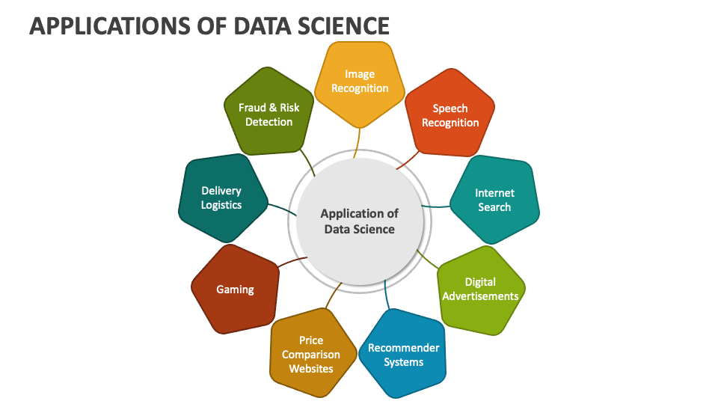
4

Slide 22
1. Recommendation Systems : Suggest products, movies, videos, songs, or services to users based on their interests, preferences, and previous activities based on browsing history, user rating, purchase history etc
Examples: Netflix, YouTube, Amazon - recommends movies and web series based on user viewing history
2. Image Recognition: identifying objects, people, places, or patterns in digital images
Examples:
Face detection - Smartphones use face recognition for unlocking devices
Medical imaging - detect tumors or fractures more accurately
Security systems - Airports use facial recognition to identify criminals or missing persons

Slide 23
3. Speech Recognition: converts human speech into text or commands using AI and Natural Language Processing (NLP)
Examples: Siri, Alexa, Google Assistant
4. Predictive Analytics
Predicts future outcomes using historical data.
5. Fraud Detection
Identifies unusual financial activities.
6. Autonomous Vehicles
Self-driving cars use Data Science for decision-making.

Slide 24
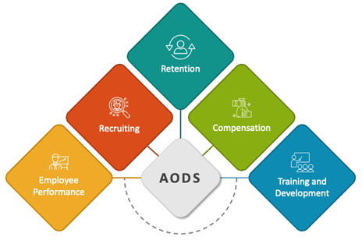
Applications of Data Science in HR Analytics
Talent Acquisition
  Predictive modeling for candidate sourcing
  Resume parsing and screening automation
  Behavioral analysis for cultural fit assessment
Employee Retention
  Attrition prediction using machine learning algorithms
  Identifying factors contributing to employee turnover
  Personalized retention strategies based on risk assessment
Performance Management
  Predictive analytics for performance forecasting
  Feedback sentiment analysis for performance reviews
  Individualized development plans based on skill gap analysis

Slide 25
APPLICATIONS OF DATA SCIENCE IN HR ANALYTICS
Workforce Planning
Demand forecasting for future workforce needs
Skills inventory analysis for succession planning
Optimal staffing levels based on workload prediction
Employee Engagement
  Sentiment analysis of employee feedback
  Engagement score prediction using NLP techniques
  Customized engagement initiatives based on sentiment analysis results
Diversity and Inclusion
  Bias detection in recruitment and promotion processes
  Diversity metrics tracking and reporting
  Personalized inclusion programs to address diversity gaps

Slide 26
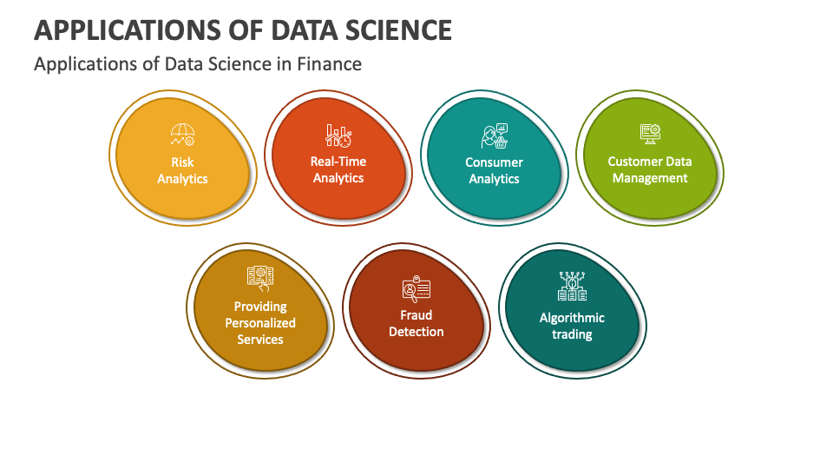

Slide 27
Applications of Data Science in Finance
Risk Management
  Predictive modeling for credit risk assessment
  Fraud detection using anomaly detection algorithms
  Market risk analysis and stress testing
Algorithmic Trading
  Automated trading strategies based on machine learning
  Sentiment analysis of news and social media for trading signals
  High-frequency trading optimization
Customer Segmentation
  Behavioral analysis for personalized marketing campaigns
  Churn prediction to retain high-value customers
  Customer lifetime value prediction for targeted acquisition

Slide 28
APPLICATIONS OF DATA SCIENCE IN FINANCE
Portfolio Optimization
  Asset allocation using modern portfolio theory
  Risk-return optimization with Monte Carlo simulations
  Dynamic rebalancing based on market trends and portfolio goals
Fraud Detection
  Transaction monitoring for detecting fraudulent activities
  Pattern recognition in financial transactions
  Network analysis to uncover complex fraud schemes
Regulatory Compliance
  Anti-money laundering (AML) compliance using predictive analytics
  GDPR and CCPA compliance through data governance frameworks
  Automated reporting for regulatory filings

Slide 29
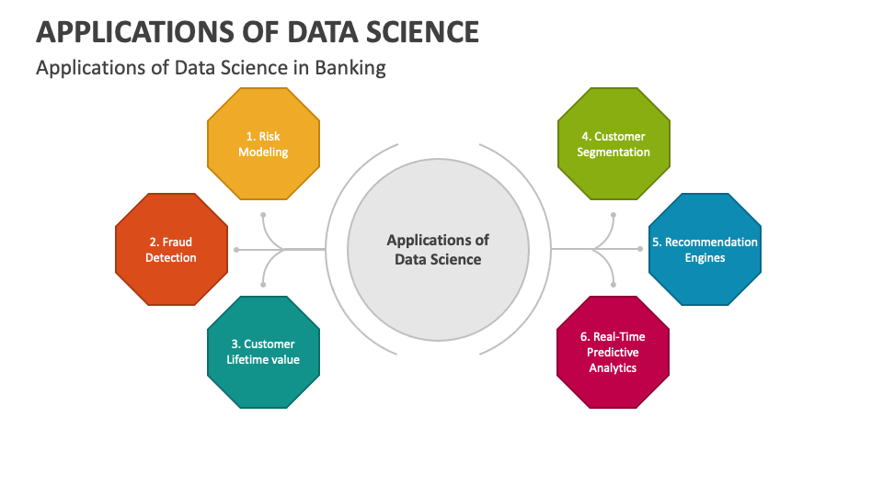

Slide 30
Applications of Data Science in Banking
Credit Scoring
  Predictive modeling for assessing creditworthiness
  Automated loan approval processes
  Risk-based pricing strategies
Fraud Detection
  Anomaly detection algorithms for identifying suspicious activities
  Real-time transaction monitoring
  Behavioral analysis for fraud pattern recognition
Customer Relationship Management (CRM)
  Personalized product recommendations
  Churn prediction and customer retention strategies
  Customer segmentation for targeted marketing campaigns

Slide 31
APPLICATIONS OF DATASCIENCE IN BANKING
Risk Management
Market risk analysis using predictive analytics
Stress testing and scenario analysis
Compliance monitoring and regulatory reporting
Operations Optimization
Process automation for efficiency gains
Predictive maintenance for ATM networks
Supply chain optimization for inventory management
Sentiment Analysis
Social media and customer feedback analysis
Brand sentiment tracking
Reputation management and crisis response

Slide 32
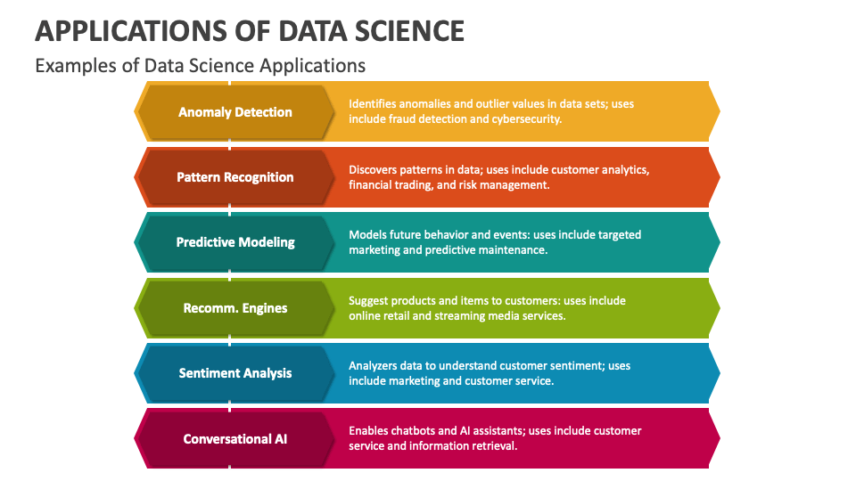

Slide 33
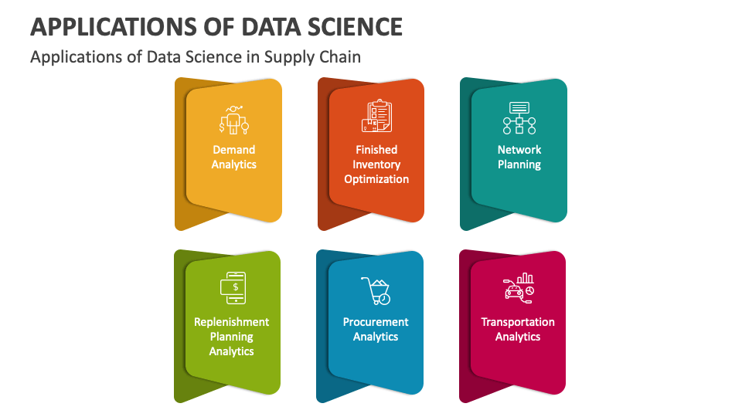

Slide 34
Applications of Data Science in Supply Chain
Demand Forecasting
  Predictive analytics for accurate demand prediction
  Seasonal trend analysis for demand fluctuations
  Machine learning models for dynamic forecasting
Inventory Optimization
  Real-time inventory tracking and management
  Automated replenishment based on demand forecasting
  Optimization algorithms to minimize carrying costs
Supply Chain Visibility
Real-time monitoring of shipments and inventory levels
Predictive analytics for identifying potential disruptions
Block chain technology for enhanced transparency and traceability

Slide 35
APPLICATIONS OF DATASCIENCE IN SUPPLY CHAIN
Supplier Relationship Management
Predictive analytics for supplier performance evaluation
Risk assessment and mitigation strategies
Supplier collaboration platforms for improved communication
Transportation and Logistics Optimization
Route optimization for efficient transportation
Dynamic scheduling to minimize delays and costs
Fleet management optimization for resource efficiency

Slide 36
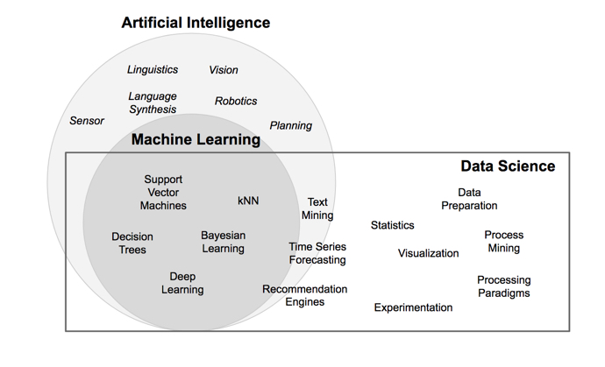
AI, MACHINE LEARNING, AND DATA SCIENCE

Slide 37
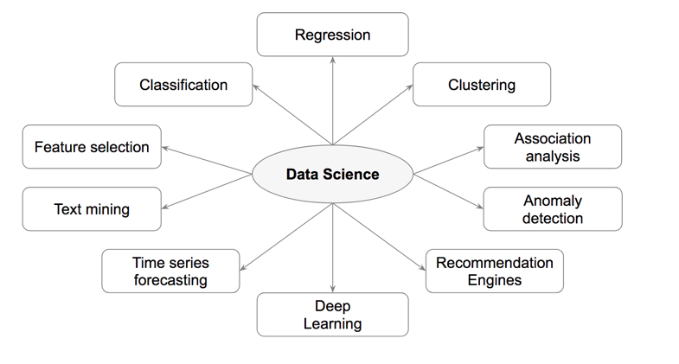
DATA SCIENCE CLASSIFICATION

Slide 38
Tasks | Description | Algorithms | Examples
Classification | Predict if a data point belongs to one of predefined classes. The prediction will be based on learning from known data set. | Decision Trees, Neural networks, Bayesian models, Induction rules, K nearest neighbors | Assigning voters into known buckets by political parties eg: soccer moms. Bucketing new customers into one of known customer groups.
Regression | Predict the numeric target label of a data point. The prediction will be based on learning from known data set. | Linear regression, Logistic regression | Predicting unemployment rate for next year. Estimating insurance premium.
Anomaly detection | Predict if a data point is an outlier compared to other data points in the data set. | Distance based, Density based, LOF | Fraud transaction detection in credit cards. Network intrusion detection.
Time series | Predict if the value of the target variable for future time frame based on history values. | Exponential smoothing, ARIMA, regression | Sales forecasting, production forecasting, virtually any growth phenomenon that needs to be extrapolated
Clustering | Identify natural clusters within the data set based on inherit properties within the data set. | K means, density based clustering - DBSCAN | Finding customer segments in a company based on transaction, web and customer call data.
Association analysis | Identify relationships within an itemset based on transaction data. | FP Growth, Apriori | Find cross selling opportunities for a retailor based on transaction purchase history.

Slide 39
SELF-ASSESSMENT QUESTIONS
Data science is also known as
Data Driven science
Data Mining
Big data
Information retrival
2. Data preprocessing, cleaning, and feature engineering.
a) Data Scientist
b) Machine Learning Engineer
c) Data Analyst
d)None

Slide 40

THANK YOU
Team – DS

